Slide 1
Locating Data and Statistics
Jenny Colvin, Outreach Librarian
7 November 2018

Slide 2
All Sources Are in LibGuides
Course guide:
https://libguides.furman.edu/csc105giabbanelli/home

Slide 3
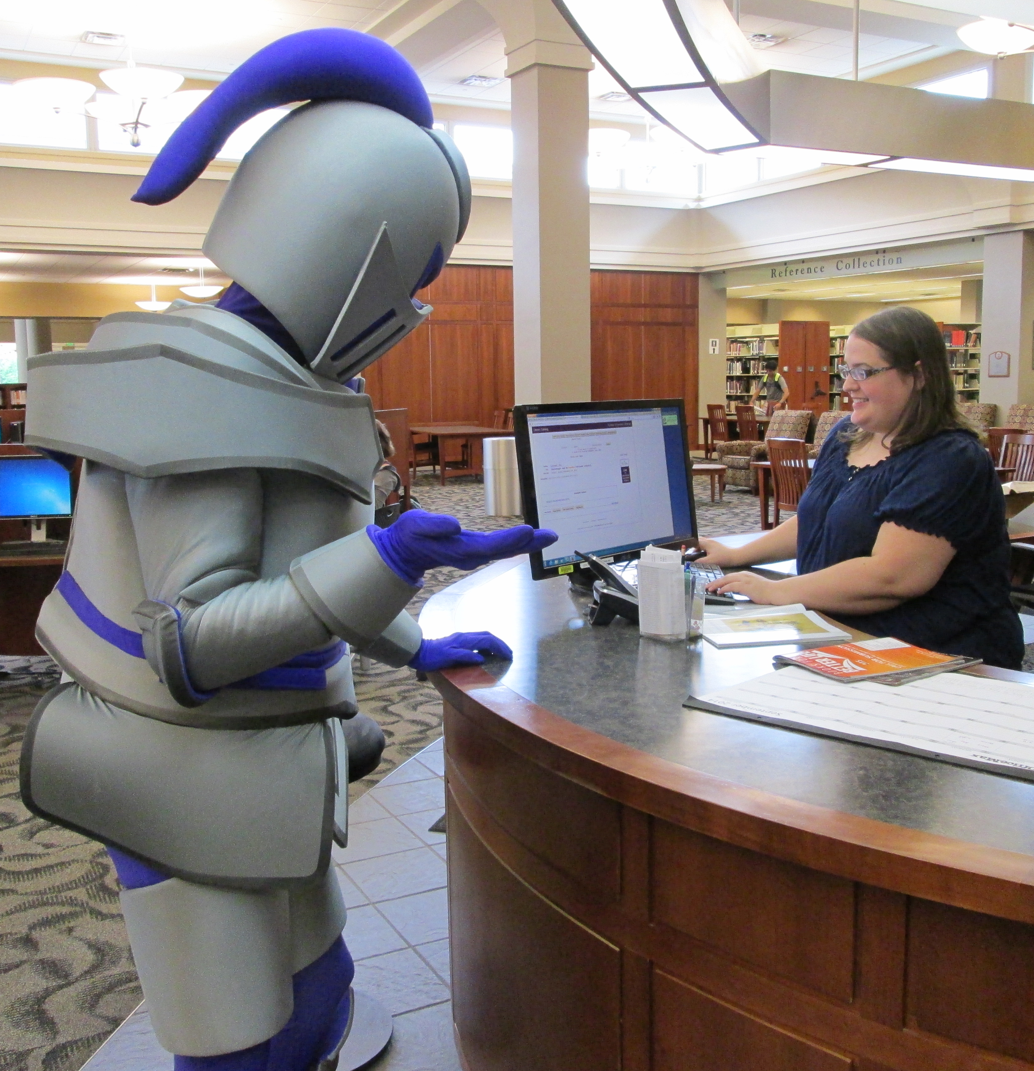
ProQuest Statistical Abstracts
Physically housed behind the Research Assistance Desk

Slide 4

Start with the print
The index is so much easier than wading through searches online

Slide 5
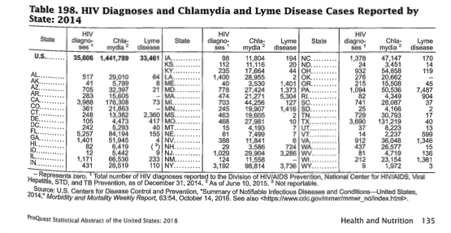
Strategies
Identify relevant tables
Note the source
Follow the source

Slide 6
Morbidity and Mortality Weekly Report
https://www.cdc.gov/mmwr/mmwr_nd/index.html
LOOK FOR LINKS TO DATA

Slide 7
More online data sets
Course guide:
https://libguides.furman.edu/csc105giabbanelli/home

Slide 8
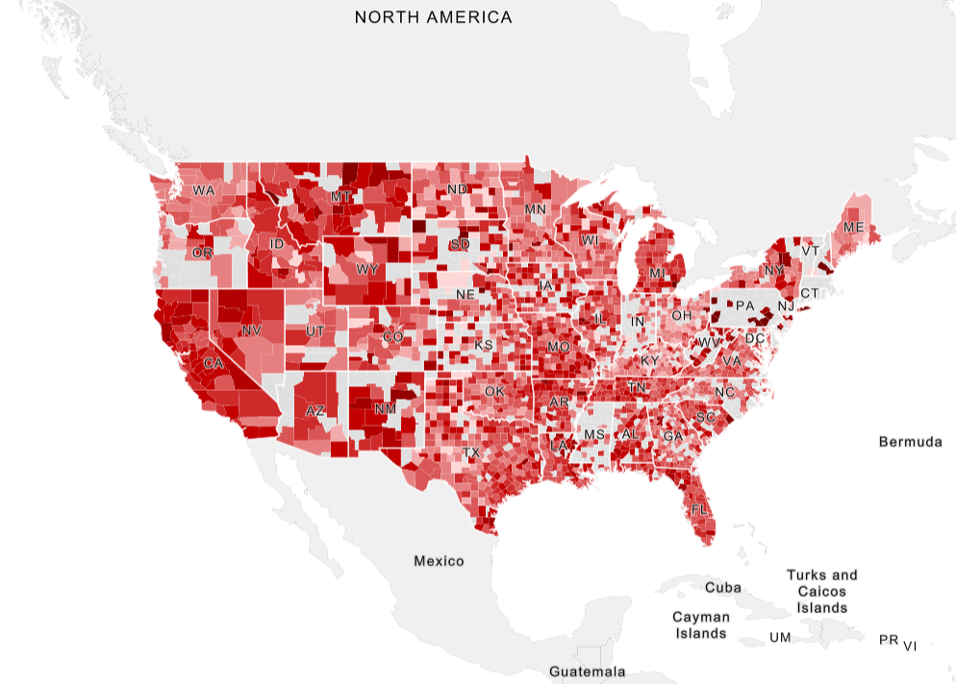
SOCIAL EXPLORER

Slide 9
SOCIAL EXPLORER
Visualize with maps
Use reports
Run reports with selected data fields
Export data
Save projects

Slide 10
SOCIAL EXPLORER
Provided by Furman University Libraries
Can be found on All Databases pages
https://libguides.furman.edu/databases/21175655

Slide 11
Still need help?
How to schedule an appointment with me

